Slide 1
ONLINE SHOPPERS PURCHASING INTENTION
Final Presentation
Presented By:-
Group No. 11
PGP DSE December 2019
Bangalore
Research Supervisor:-
Dr. Dipanjan Goswami

Slide 2
Table Of Contents
Introduction
Problem Statement
Dataset Description
Exploratory Data Analysis
Feature Engineering
Clustering
Model Assumptions and Base Model
Model evaluation and insights
Business insights
Summary table

Slide 3



1.Introduction
US eCommerce accounted for:
2000 – 1% of retail
2010- 17% of retail
2018 – 14.3% of retail
Source: https://jilt.com/blog/decade-ecommerce-2010s/
Indian e-commerce market is expected to grow to US$ 200 billion by 2026 from US$ 38.5 billion in 2017.
Source: India Brand Equity Foundation [updated: March2020]
In 2000, Kmart was the third-largest US retailer, with $36 billion in sales; by 2014, its annual revenues had declined by two-thirds.
Over the same period, Amazon’s annual sales grew to $89 billion from about $2.8 billion.
Alibaba, was only a 15-year-old company when in 2014 it filed the largest IPO ever, valued at $25 billion
Source: McKinsey report: The consumer sector in 2030: Trends and questions to consider

Slide 4
2.Problem Statement
Though the rise of E-Commerce tradition over the past few years has created potential in the marketplace, most of the visitors still do not complete their online shopping process due to various reasons.
This leads the online vendors the need for solutions to prevent the loss of their revenues.
Based on this information, our group has derived two problem statements, which we aim to address in this project:
The factors that influence the visitor’s intention on the online shopping environment
Machine learning models to predict the likelihood of their revenue generation based on the relevant factors.

Slide 5
3.Dataset Description
The dataset consists of feature vectors belonging to 12330 sessions. The dataset was formed so that each session would belong to a different user in a one year to avoid any tendency to a specific campaign, special day, user profile, or period.
The data used in this analysis is an Online Shoppers Purchasing Intention data set provided on the UC Irvine’s Machine Learning Repository.
The primary purpose of the data set is to predict the purchasing intentions of a visitor to this particular store’s website.

Slide 6
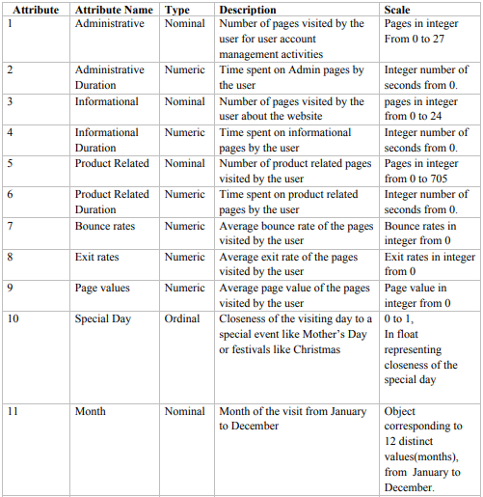
Dataset Description(Cont..)
The dataset consists of 10 numerical and 8 categorical attributes.

Slide 7
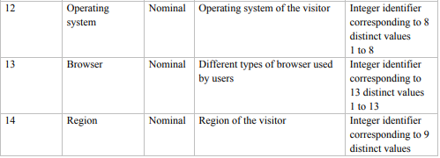
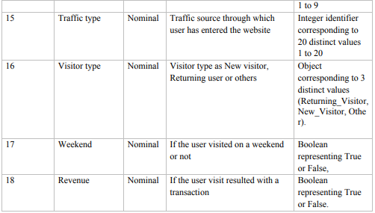
Dataset Description(Cont..)

Slide 8
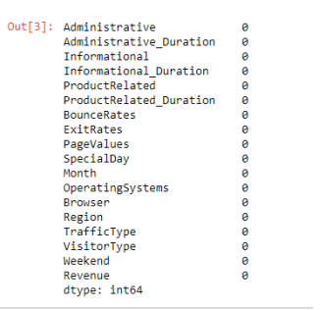
Dataset Description(Cont..)
NULL VALUES:
This dataset does not have any null values. Hence, we can proceed without imputation or other mechanisms on the dataset.

Slide 9
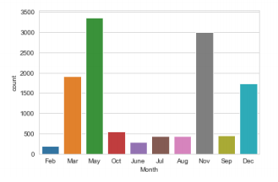
4.EXPLORATORY DATA ANALYSIS
4.1 RELATIONSHIP BETWEEN VARIABLES
4.1.1 Uni-variate Analysis
a. Users in every month

Slide 10
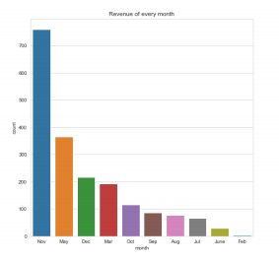
b. Revenue in every month
Revenue was observed to be at its peak in the month of November.
Followed by a drastic drop in December and the following two months until a slight traction in March.
There is again a dull period in April with a sudden increase in May

Slide 11
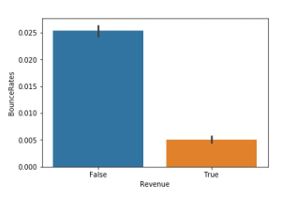
4.1.2 Bi-Variate Analysis
a. Revenue and Bounce Rates:
According to the above chart we observe that revenue is not generated when the bounce rates are high.

Slide 12
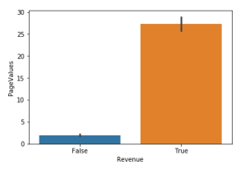
b. Revenue and Page Value:
Here according to the above chart, we understand that higher the page values, higher the conversion to revenue.

Slide 13
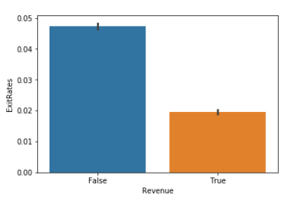
c. Revenue and Exit Rates:
From above it shows us that exit rates and revenue are inversely proportional to each other.
As exit rates are more the conversion to revenue is less.

Slide 14
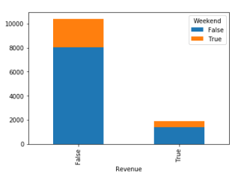
d. Weekend and Revenue:
Revenue was higher during weekdays when compared to weekends.
The proportion of users visiting a shopping site is also more during weekdays.
This could be because of the availability of free internet from work places, work related purchases etc.

Slide 15
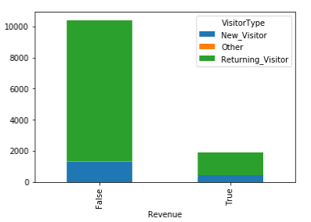
e. Visitor type and Revenue:
The conversion to revenue was higher from returning visitors than new visitors.
Also it is alarming that a good number of visitors are returning without actually making a purchase.
This could be an interesting population to whom promotions and discounts could be offered to persuade them buy products.

Slide 16
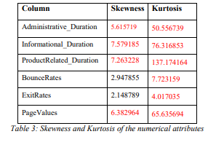
4.2 DISTRIBUTION OF DATA

Slide 17
ADMINISTRATIVE DURATION:
Distribution range - 0 to 3,400 seconds.
Skewness - 5.61 - right skewed
Mean - 81 seconds - most of the distribution at the beginning - considerate amount of time is spent on the administrative pages.
Kurtosis -50.55 - significant weight in the tails - Leptokurtic distribution.
INFORMATIONAL DURATION:
Distribution range - 0 to 2,550 seconds.
Skewness -7.57 - right skewed.
Mean -34.5 seconds - which infers that most of the distribution lies at the beginning which in turn infers that less amount of time is spent on the informational pages.
Kurtosis - 76.31 - considerate weight in the tails - Leptokurtic distribution.

Slide 18
PRODUCT RELATED DURATION:
Distribution - 0 to 63,974 seconds.
Skewness -7.26 - right skewed.
Mean -1195 seconds - most of the time in a website is spent on the Product Related pages as it an ecommerce website.
Kurtosis -137.17 - heavier weight in the tails - Leptokurtic distribution.
BOUNCE RATES:
Distribution range - 0 to 0.20.
Skewness -2.94 - right skewed.
Mean - 0.0221.
Kurtosis -7.72 - lighter weight in the tails - Leptokurtic distribution.

Slide 19
EXIT RATES:
Distribution range - 0 to 0.20.
Skewness of 2.14 - right skewed - the smaller value of skewness indicates the closeness to normal distribution.
Mean -0.043.
Kurtosis - 4.01 - lighter weight in the tails - Leptokurtic distribution.
PAGE VALUES:
Distribution range - 0 to 362.
Skewness - 6.38 - right skewed
Mean -18.56.
Kurtosis - 65.63 - heavier weight in the tails - Leptokurtic distribution.

Slide 20
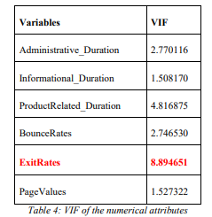
4.3 MULTICOLLINEARITY
From the table, it is evident that ExitRates has multicollinearity effect on the variables.
2. As a result, ExitRates feature will be removed for further work.

Slide 21
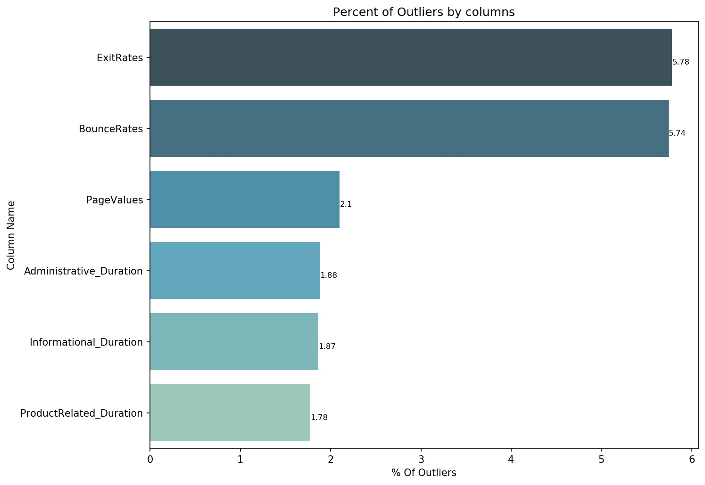
4.4 OUTLIERS AND ITS TREATMENT
ExitRates and BounceRates have outliers more than 5% of the data.
Hence, the outliers in these variables can be referred to extreme values which can be transformed or be imputed with median of the variables.
The other variable outliers can be negotiated as the number of outliers is negligible compared to the whole data.

Slide 22
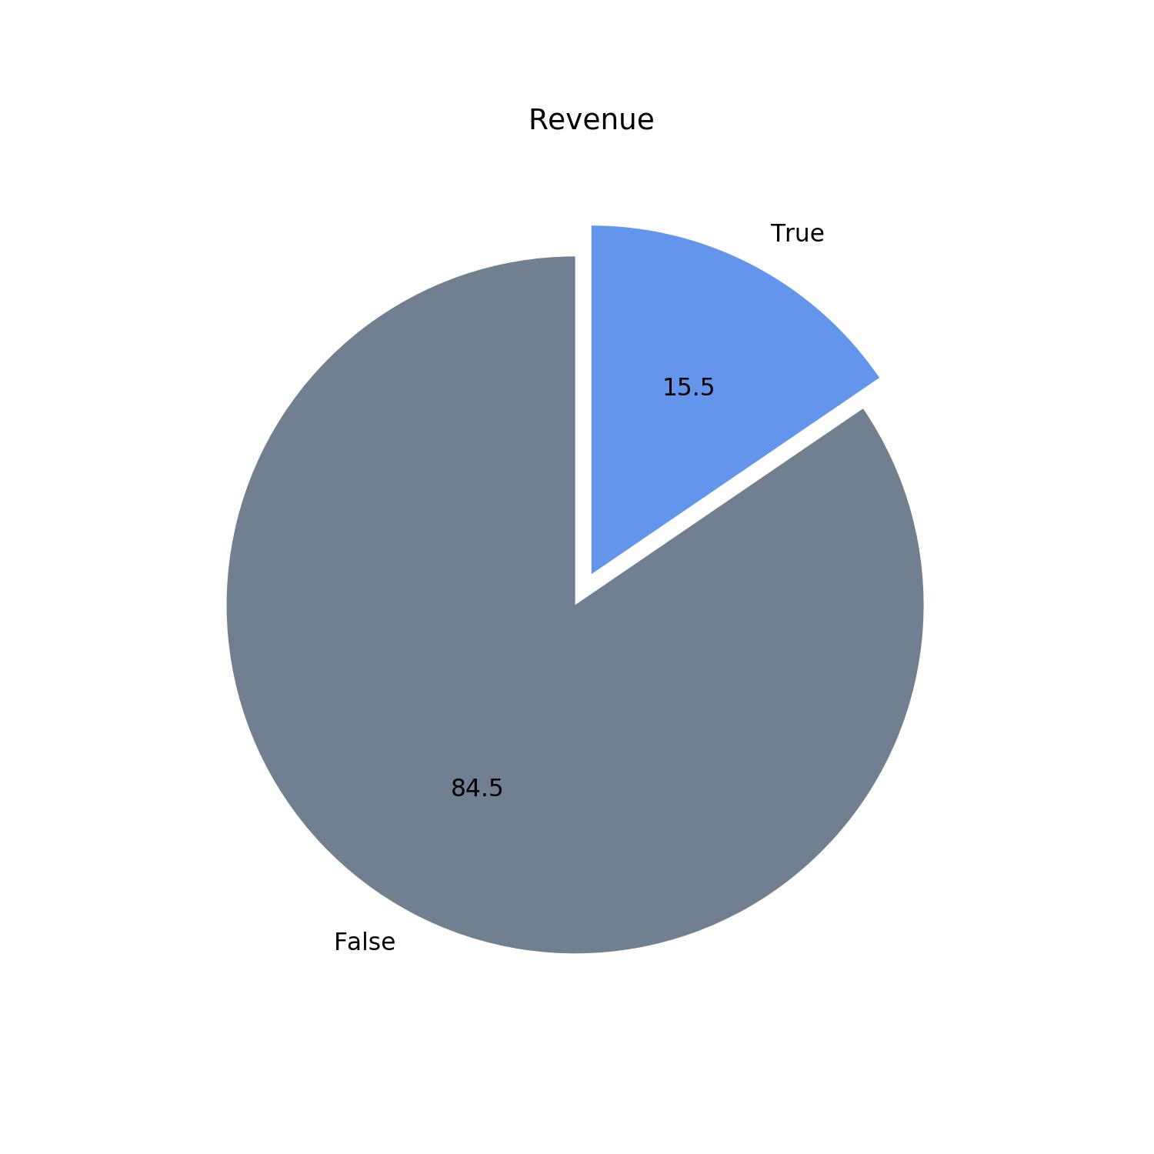
4.5 CLASS IMBALANCE AND ITS TREATMENT
84.5% - ‘False’ category(10422)
15.5% - ‘True’ category(1908)
Major problem - it creates a bias towards the majority class and result in poor overall performance of the model.
SMOTE is an oversampling technique to synthesize training samples in the feature space. Based on nearest neighbors judged by Euclidean Distance between data points in feature space.

Slide 23
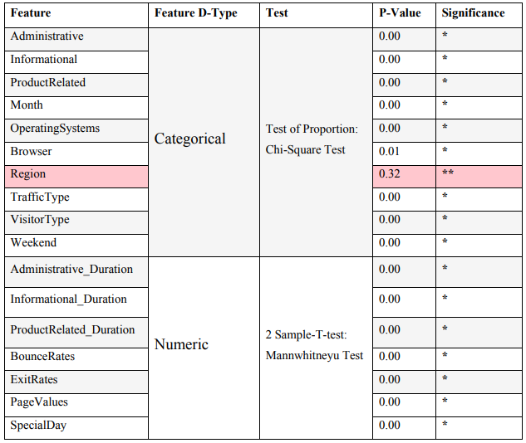
5.6 STATISTICAL SIGNIFICANCE OF FEATURES
The feature ‘Region’ - statistically insignificant to the target variable.
Hence ‘Region’ Feature will not be considered for the model building as they do not affect the target variable.
*- Significant
**- Insignificant

Slide 24
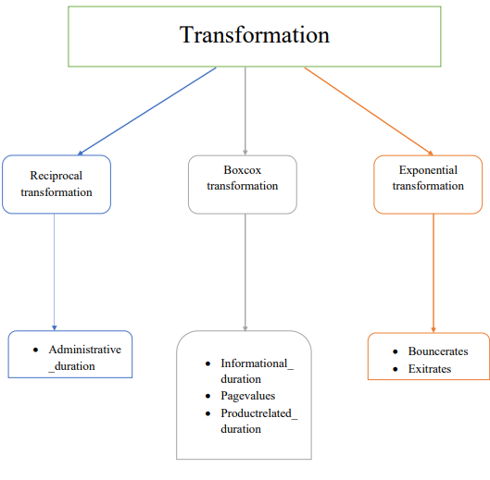
5. FEATURE ENGINEERING
5.1 TRANSFORMATIONS:-

Slide 25
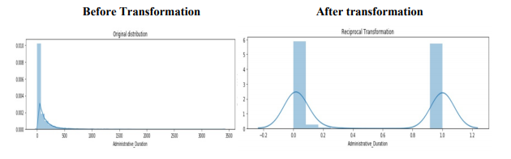
5.1.1. TRANSFORMATION OF NUMERICAL FEATURES
Administrative_Duration Column:
Administrative duration column had a skewness of 5.61 and it was reduced to 0.075 by applying Reciprocal transformation.

Slide 26
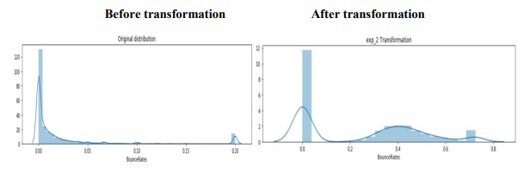
BounceRates Column:
Bounce Rates column had a skewness of 2.94 and it was reduced to 0.26 by applying Exponential transformation to the power of 0.2.

Slide 27
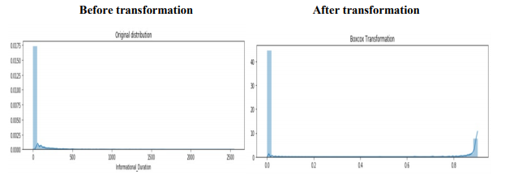
Informational_Duration Column:
Informational duration column had a skewness of a7.57 and it was reduced to 1.54 by applying Boxcox transformation.

Slide 28
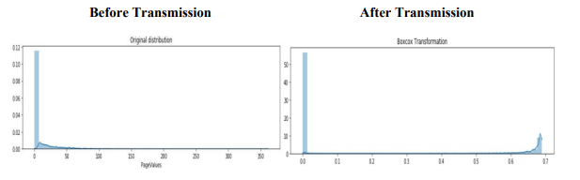
PageValues Column:
Page Values column had a skewness of 6.38 and it was reduced to 1.377 by applying Boxocox transformation

Slide 29
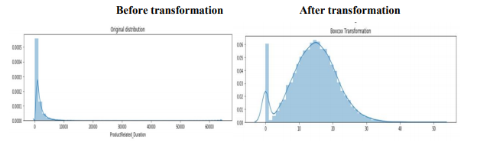
ProductRelated_Duration Column:
Product Related duration column had a skewness of 7.26 and it was reduced to -0.036 by applying Boxcox transformation.

Slide 30
5.1.2 TRANSFORMATION OF CATEGORICAL FEATURES
Transformations for categorical features were done by either label encoding or one hot encoding.
TRAFFICTYPE column had 20 sub-categories. Top 10 sub-categories having highest counts were considered.
BROWSER column had 13 sub-categories. Top 8 sub-categories having highest counts were considered.
MONTH column had 10 sub-categories. Top 8 sub-categories having highest counts were considered.
OPERATINGSYSTEM column had 8 sub-categories. Top 5 sub-categories having highest counts were considered.
VISITORTYPE column had 3 sub-categories. 3 dummy columns were created.
WEEKEND and REVENUE columns were label encoded as 0 and 1.

Slide 31
Factor Analysis
Factor analysis is a linear statistical model. It is used to describe the variance amongst the observed variable and condense a set of the observed variable into the unobserved variable called factors.
Factor or latent variable is associated with multiple observed variables, who have common patterns of responses
Each factor explains a particular amount of variance in the observed variables and helps in data interpretations by reducing the number of variables.

Slide 32
Adequacy Test
Before you perform factor analysis, you need to evaluate the “factorability” of our dataset. Factorability means "can we found the factors in the dataset?". There are two methods to check the factorability or sampling adequacy:
Bartlett’s Test
Kaiser-Meyer-Olkin Test

Slide 33
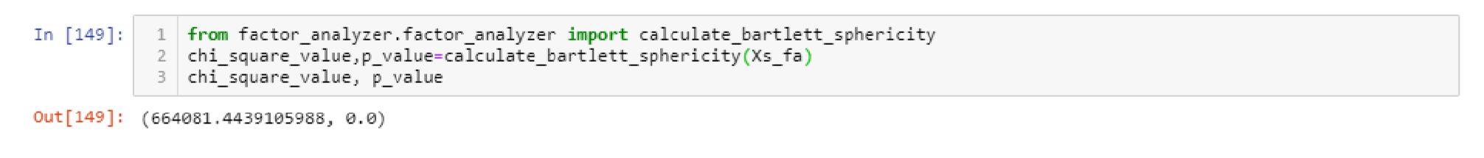
Bartlett’s Test:
Bartlett’s test of sphericity checks whether or not the observed variables intercorrelate at all using the observed correlation matrix against the identity matrix. If the test found statistically insignificant, you should not employ a factor analysis.
In this Bartlett ’s test, the p-value is 0. The test was statistically significant, indicating that the observed correlation matrix is not an identity matrix.

Slide 34
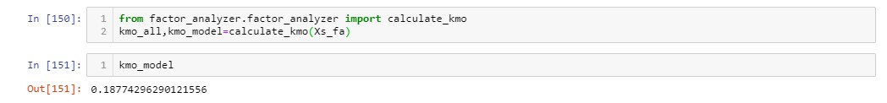
Kaiser-Meyer-Olkin Test
Kaiser-Meyer-Olkin (KMO) Test measures the suitability of data for factor analysis.
KMO values range between 0 and 1. Value of KMO less than 0.6 is considered inadequate.
The overall KMO for our data is 0.18, which is a bad score. This value indicates that our data is inadequate for factor analysis, hence we do not proceed with factor analysis.
Hence, we move to PCA (Principle Component Analysis) for dimensionality Reduction.

Slide 35
Principal Components Analysis (PCA)
In statistics, principal component analysis (PCA) is a method to project data in a higher dimensional space into a lower dimensional space by maximizing the variance of each dimension.
Unlike other linear transforms, the PCA does not have a fixed set of basis vectors, its basis vectors depend on the data set.

Slide 36
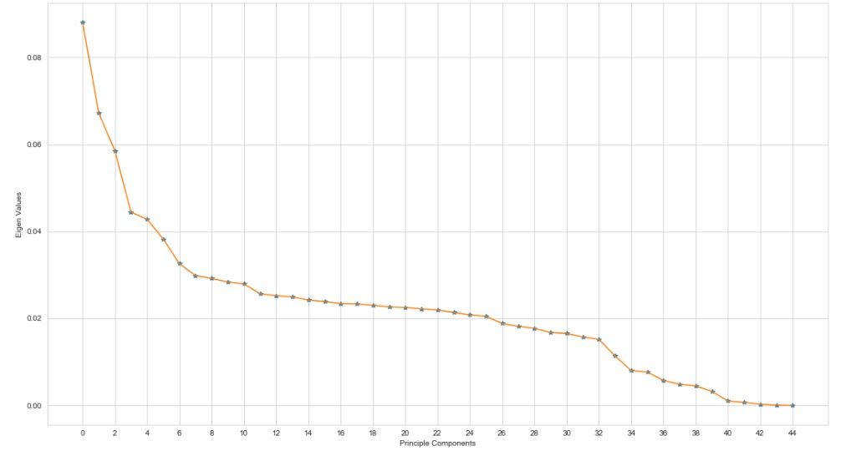
Data Visualization using PCA
Scree Plot :-
A scree plot is a diagnostic tool to check whether PCA works well on data or not.

Slide 37
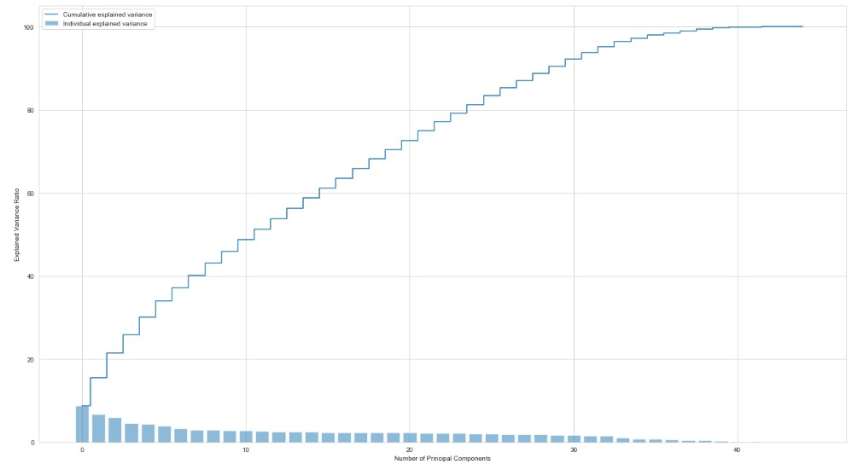
Proportion of variance plot
Explained variance is the amount of variance explained by each of the selected components.
Explained variance ratio is the percentage of variance explained by each of the selected components.

Slide 38
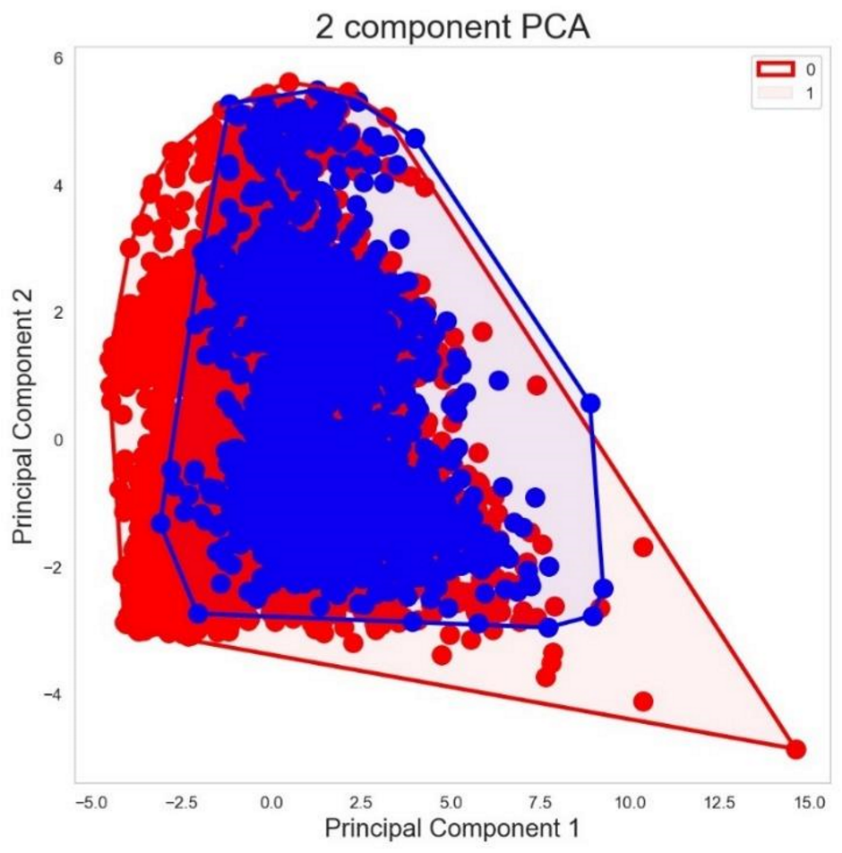
Scatter plot of PCA1 and PCA2
If you draw a scatterplot against the first two PCs, the clustering of data points of 0 and 1are clearly visible.

Slide 39
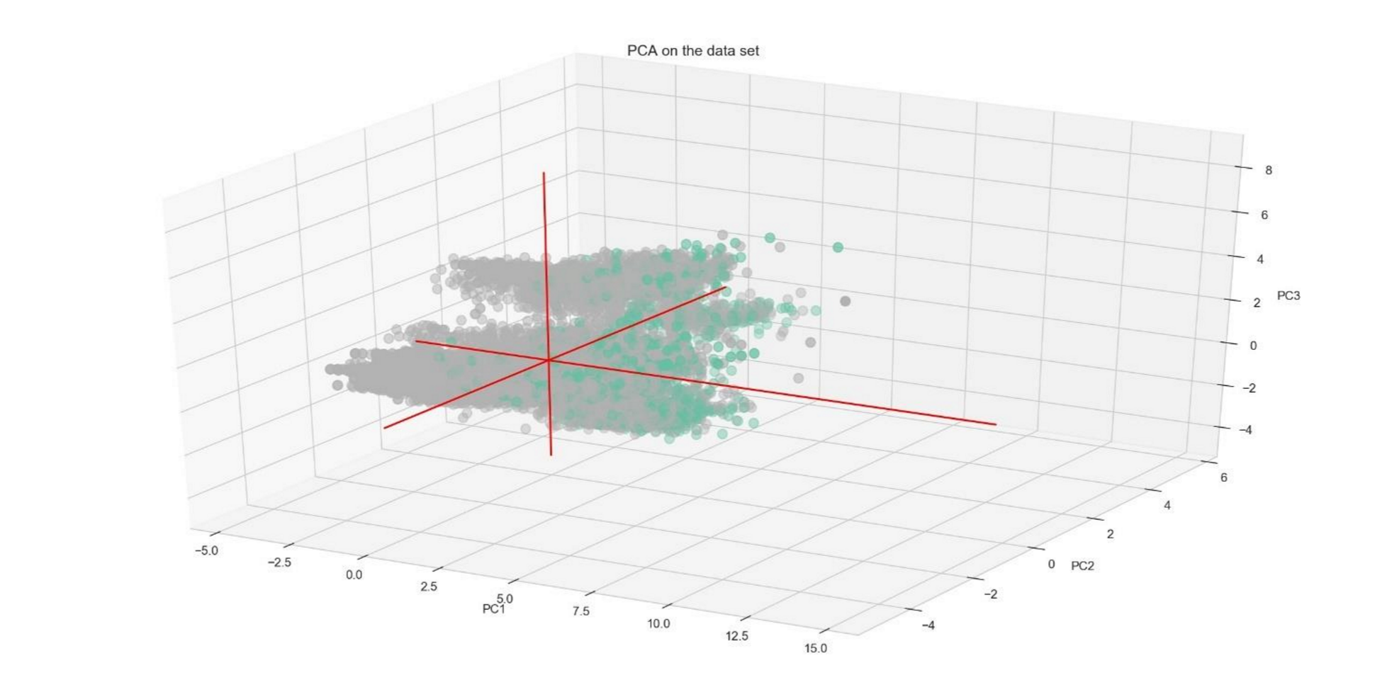
In the 2D picture, though there is an overlap, yet the points belonging to the same category are distinctly clustered and region bound.
.Since we do not have a clear picture in 2D scatter plot, we plot a 3D plot in order to have a clear picture.
From the 3D plot, we can say that, though there is a certain degree of overlap, the points belonging to the same category are distinctly clustered and region bound.
This proves that the data captured in the first three PCs is informative enough to discriminate the categories from each other.
In other words, we now have evidence that the data is not completely random, but rather can be used to discriminate or explain the Y.

Slide 40
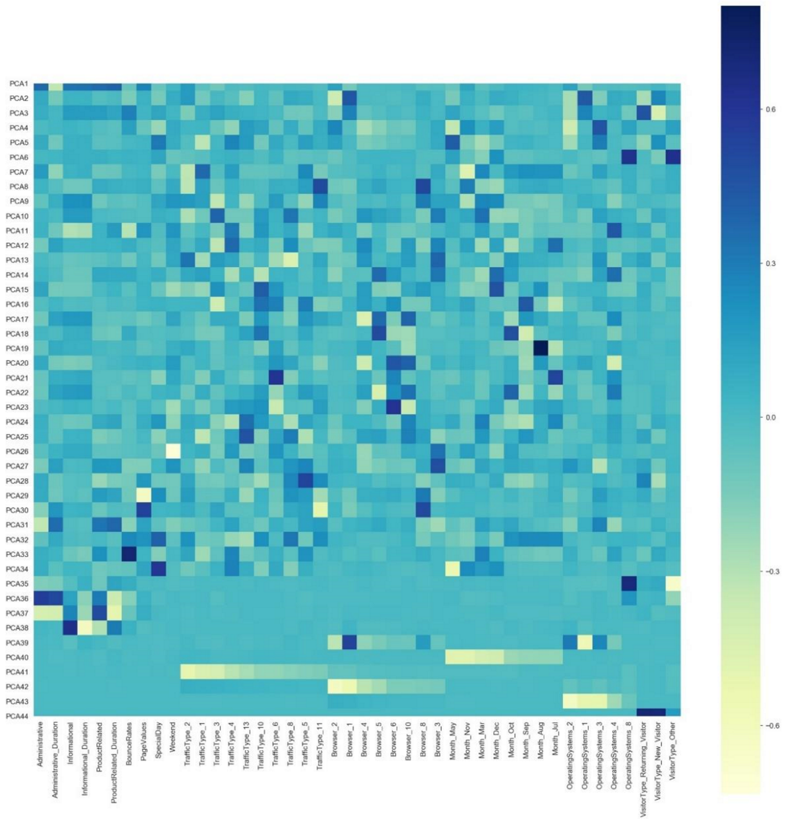
Effect of variables on each component
Below heat map and the color bar basically represent the correlation between the various feature and the principal component itself.

Slide 41
PCA Biplot
Biplot is an interesting plot and contains lot of useful information.
It contains two plots:
1. PCA scatter plot which shows first two components (We already plotted this above).
2. PCA loading plot which shows how strongly each characteristic influences a principal component.

Slide 42
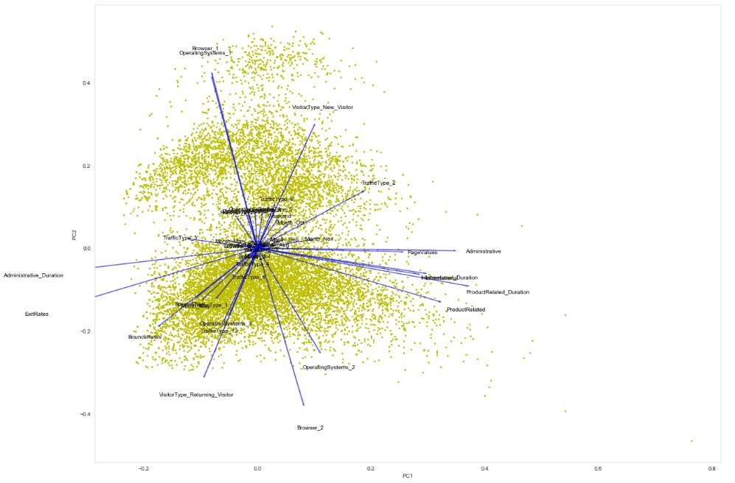
The angles between the vectors tell us how characteristics correlate with one another
When two vectors are close, forming a small angle, the two variables they represent are positively correlated. [Browser2 and OperatingSyatem_2]
If they meet each other at 90°, they are not likely to be correlated. [Administrative_Duration and Browser1]
When they diverge and form a large angle (close to 180°), they are negative correlated. [Browser2 and Browser1]

Slide 43
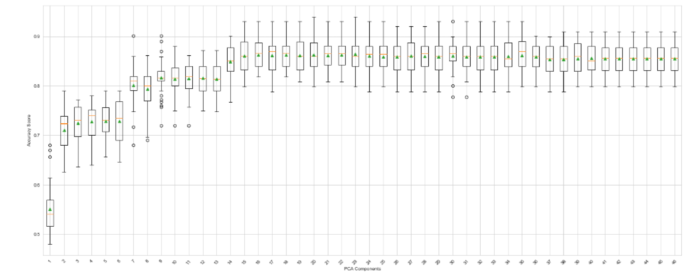
Number of Components Vs Classification Accuracy
We compute the classification accuracy using Logistic Regression for each number of components or features selected.
We can observe that there is a general trend of increased performance as the number of dimensions is increased. And there is no much improvement after 15 Components.

Slide 44
Classification Model Evaluation Using PCA Components
We perform various classification models on PCA components that explain 95% variance of the data and evaluate the results.
Model | Accuracy Score | ROC-AUC Score | Variance Error | F1-Score | Precision | Recall
Logistic | 89.38% | 91.14% | 0.000085 | 89.07% | 88.91% | 89.38%
Decision Tree | 85.74% | 73.26% | 0.000471 | 85.80% | 85.89% | 85.74%
Naive Bayes | 86.18% | 87.78% | 0.00013 | 86.19% | 86.23% | 86.18%
Random Forest | 89.20% | 91.34% | 0.000062 | 88.34% | 88.30% | 89.20%
Random Forest Tuned | 89.16% | 91.80% | 0.000049 | 88.50% | 88.34% | 89.16%
KNN | 87.08% | 83.41% | 0.000145 | 85.76% | 85.54% | 87.08%
KNN Tuned | 85.66% | 87.83% | 0.00007 | 81.33% | 83.62% | 85.66%
Ada-Boost | 88.71% | 90.57% | 0.000084 | 88.18% | 87.96% | 88.71%
LGBM | 89.50% | 91.96% | 0.00005 | 89.00% | 88.85% | 89.50%
LGBM Tuned | 88.45% | 90.65% | 0.000064 | 87.28% | 87.29% | 88.45%
Soft Voting | 89.64% | 91.99% | 0.000051 | 89.03% | 88.90% | 89.64%
Weighted Soft Voting | 89.78% | 91.92% | 0.000056 | 89.25% | 89.11% | 89.78%
XG Boost | 89.19% | 91.24% | 0.000045 | 88.71% | 88.52% | 89.19%
XG Boost Tuned | 89.51% | 91.77% | 0.000036 | 89.06% | 88.88% | 89.51%
SVM | 89.80% | 89.88% | 0.000263 | 89.39% | 89.25% | 89.80%

Slide 45
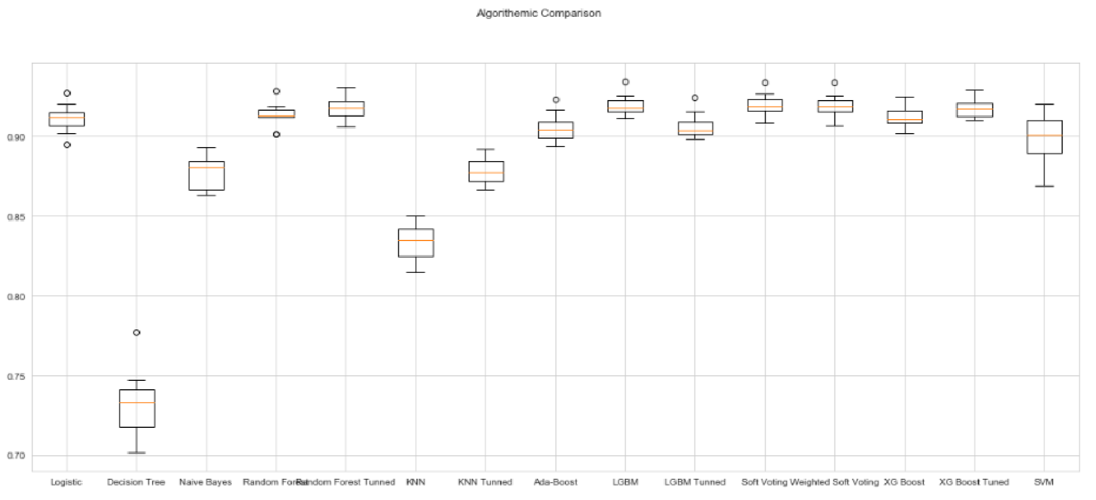

Slide 46
Based on these models, we derived the following inferences:
Soft voting performed exceptionally well giving an accuracy of 89%, ROC AUC Score of 91.96% having variance error of 0.00051.
Among the other models Weighted Soft voting, XG boost, XG boost Tuned, LGBM, Random Forest, Tuned Random Forest and Logistic Regression are the next good performers giving an accuracy score of 89% and ROC score of 91%.

Slide 47
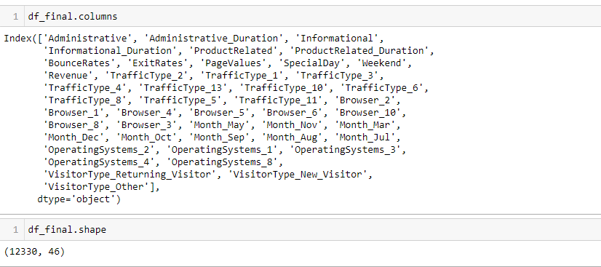
TRANSFORMED DATASET

Slide 48
5.4 FEATURE SELECTION
After the transformation process, the number of features increased to 46.
Backward Elimination Feature Selection method was used for feature selection.
The p-values of the features greater than 0.05 were eliminated.
After the feature selection process, the number of features was reduced to 19.

Slide 49
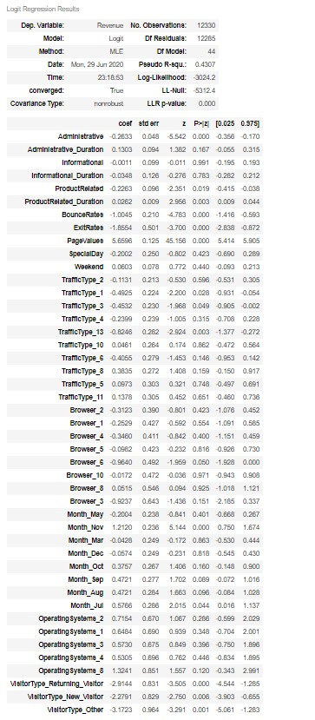
BEFORE FEATURE SELECTION

Slide 50
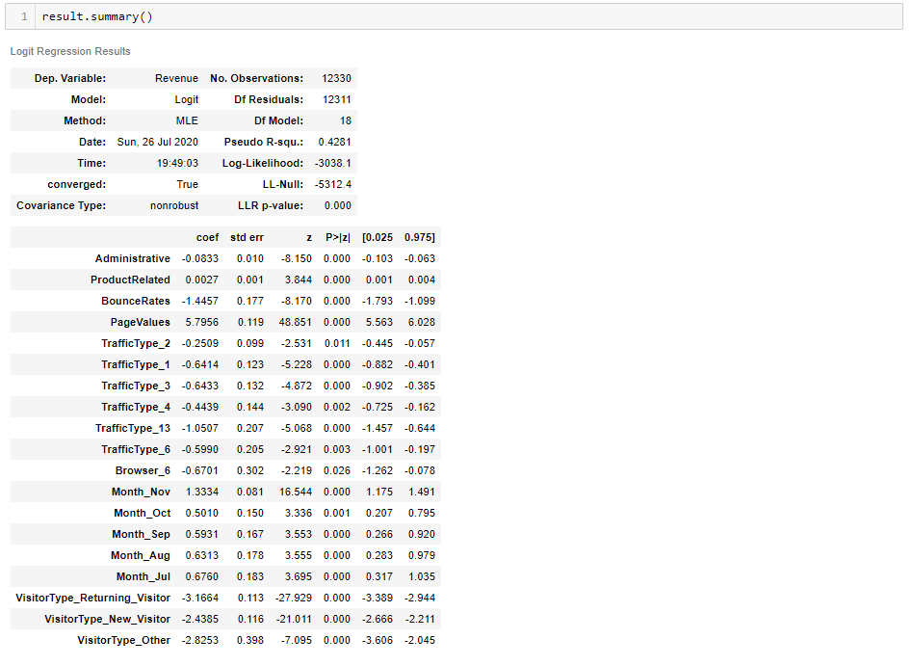
AFTER FEATURE SELECTION

Slide 51
6. CLUSTERING
Clustering has been performed to find shopping trends within the customers.
This is done in order to build “profiles” for incoming customers so that business can quickly compare them to other customers with similar characteristics from their database to assist for their reference.
Clustering algorithms have been chosen for clustering.
k-modes
Hierarchical clustering
The main reason for choosing k-modes ahead of k-means was the exhaustive number of categorical features present in the dataset.

Slide 52
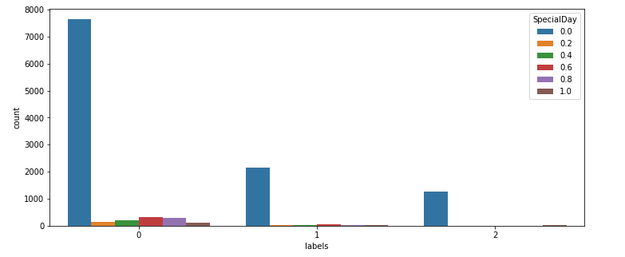
Special Day Split By Clusters:

Slide 53
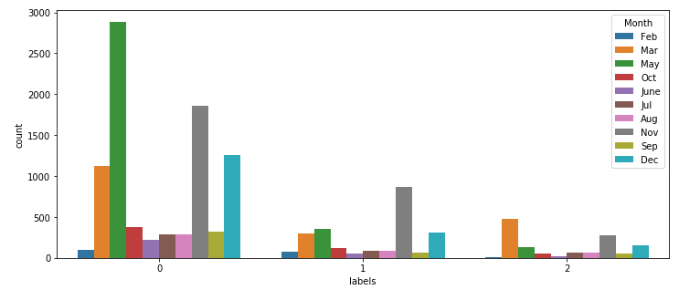
Month Split By Clusters:

Slide 54
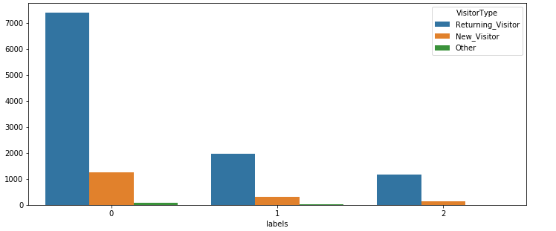
Visitor Type Split By Clusters

Slide 55
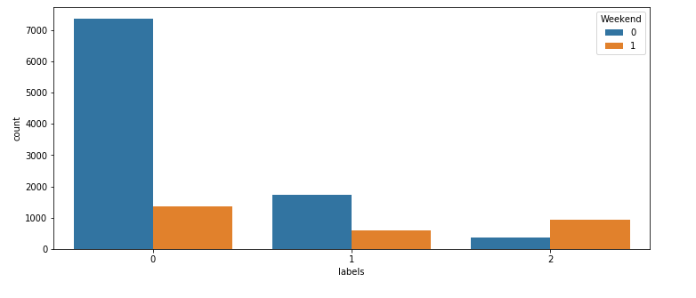
Weekend Split By Clusters

Slide 56
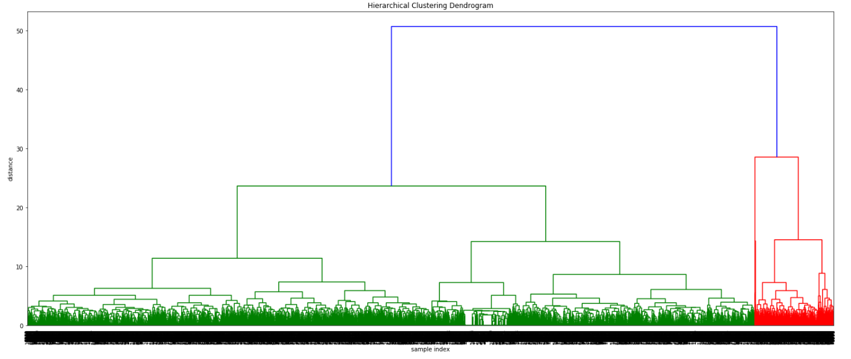
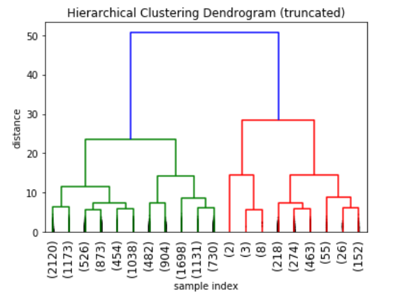
DENDROGRAM
A dendrogram is a branching diagram that signifies the relationships of likeness among a group of entities. It is most usually created as an output from hierarchical clustering.
We draw a horizontal line that passes through the blue line. Since it would cross the blue line at two points, therefore the number of clusters will be 2.

Slide 57
FINAL SELECTION
k-modes was selected as the better option because hierarchical clustering lacked inferences regarding the way clusters were built and also the pattern in the clusters were hidden.

Slide 58
7. BASE MODEL AND ASSUMPTIONS
Since,our problem that of a binary classification. We would need to build predictive binary classifier to solve our problem.
While choosing algorithms to build our model with, we decided that since Logistic Regression, Naïve-Bayes, Decision Tree, Random Forest and K-Nearest Neighbors were common models used in industry, we would try the same.

Slide 59
7.1 MODEL ASSUMPTIONS
Multicollinearity:
Logistic Regression:
Binary logistic regression requires the dependent variable to be binary. Only the significant variables should be included, the model should have little or no multicollinearity.
As already seen before, The ExitRates feature was removed as it had a multicollinearity effect.

Slide 60
Gaussian Naïve Bayes:
Naïve Bayes is a probabilistic classifier.
The major assumption associated with a Naive Bayes model is that one feature is unrelated to other features in the dataset.
Decision Tree, Random Forest and K-Nearest Neighbours are non-parametric classifier, meaning it does not need data to be meet any parameters or requirements. And hence, it does not have any assumptions.

Slide 61
BASE MODEL
We decided to proceed with all the basic models – Logistic Regression, Naïve-Bayes, Decision Tree, Random Forest and K-Nearest Neighbors.
We ran all models without any hyper parameter tuning, to get an idea of the base performances of these models and yielded results using K-Fold Cross Validation of each model.

Slide 62
7.2 Base Model Results
Model | Accuracy Score | ROC-AUC Score | Variance error | F1 Score | Precision | Recall
Logistic | 89.82% | 91.37% | 0.000089 | 89.54% | 89.41% | 89.82%
Decision Tree | 85.91% | 73.10% | 0.000135 | 85.93% | 85.97% | 85.91%
Random Forest | 89.35% | 91.05% | 0.000107 | 88.96% | 88.78% | 89.35%
Naive Bayes | 81.73% | 85.07% | 0.000177 | 83.45% | 87.08% | 81.73%
KNN | 88.88% | 86.72% | 0.000114 | 88.48% | 88.29% | 88.88%

Slide 63
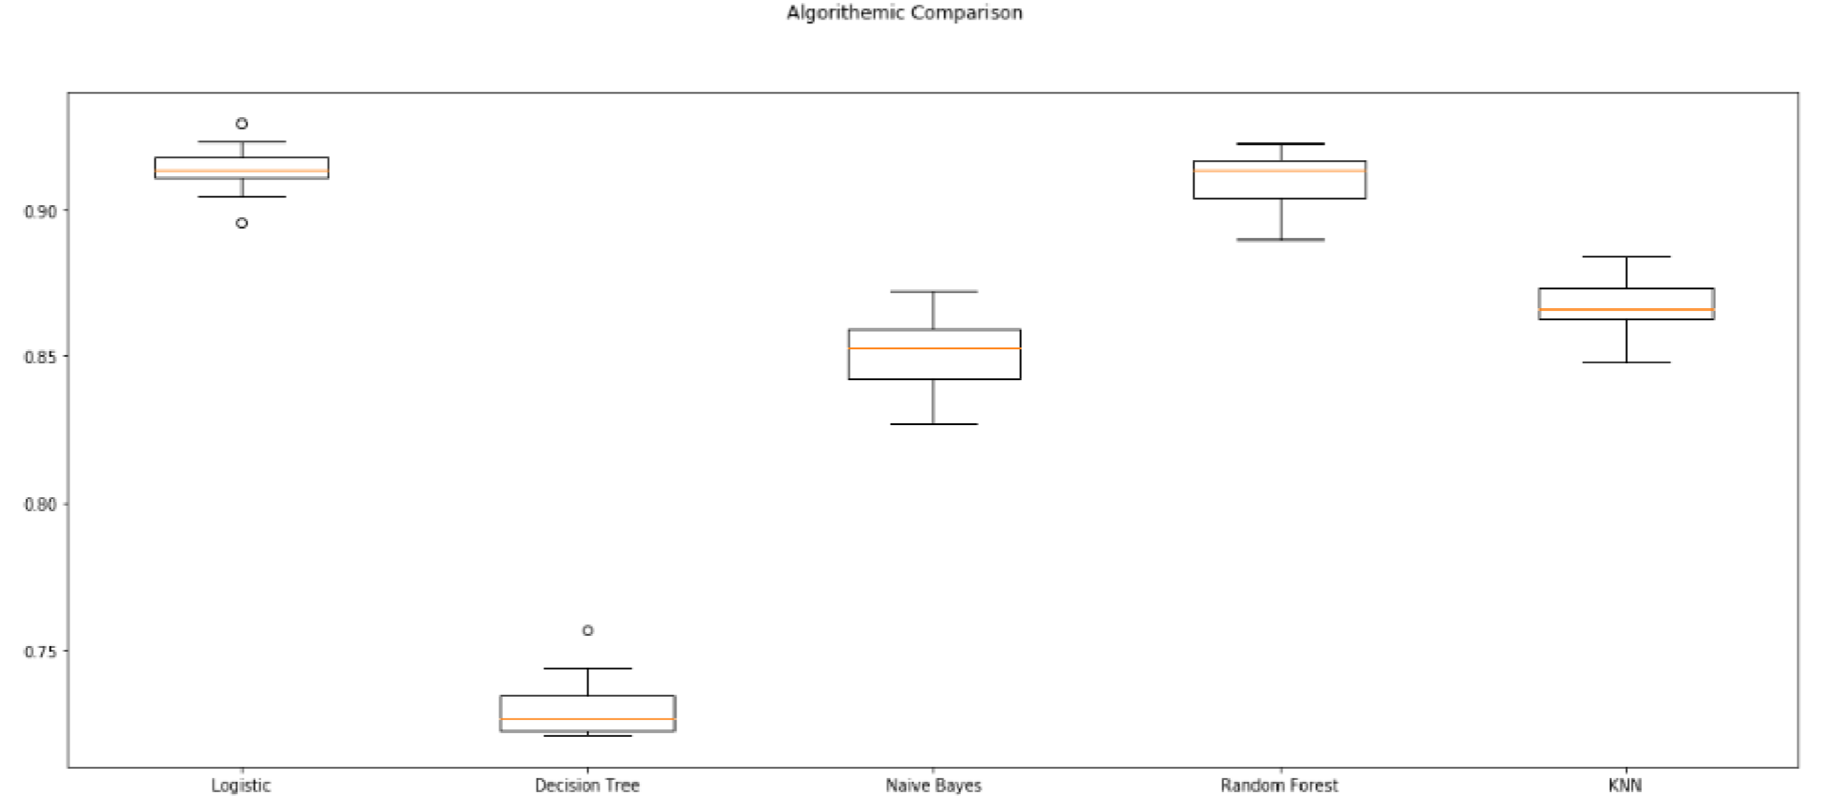
The below figure represents the box and whisker plots showing the spread of the accuracy scores across each cross-validation fold for each algorithm.

Slide 64
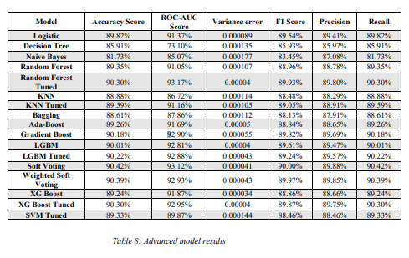
7.3 ADVANCED MODEL RESULTS

Slide 65
7.4 COMPARISON OF MODELS AFTER SMOTE
We observed that the dataset is biased towards ‘0’ revenues. (10,422 - 0’s and 1908 – 1’s)
It actually affects any model that we train and predict.
The biggest problem is that even though all the models have a higher accuracy for predicting ‘0’ revenues, accuracy of predicting ‘1’ revenues is very low.
To cater this situation, we should use SMOTE in order to oversample the imbalanced data and create a balance in the revenues.
The total number of observations was now 20,844 which was 12,330 before.

Slide 66
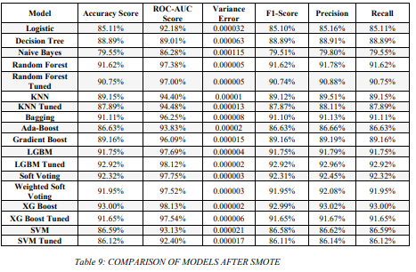
From the above table, the two Random Forest, LightGBM and XGBoost rein supremacy in every aspect of the evaluation and metrics. That being the reason, we’ll consider only these 6 models for further evaluation and insights.

Slide 67
7.5 HYPER PARAMETER TUNING:
RANDOM FOREST:
Criterion='entropy', max_depth=29, max_features=3, min_samples_leaf=2, min_samples_split=2, n_estimators=1078, random_state=0
LIGHTGBM:
learning_rate=0.045086768092742646, max_depth=18, n_estimators=445, num_leaves=67, random_state=0
XGBOOST:
subsample=0.6, min_child_weight=10, max_depth=5, gamma=1.5, colsample_bytree=0.6

Slide 68
7.6 CONCERNS OF MISCLASSIFICATION
SMOTE was applied for treating imbalance so that there was no skewness in distribution of target variable.
class_weight parameter was used and model was run which yielded the same results proving no misclassification. (class_weight=‘balanced’ or class_weight={0:0.59,1:3.22})
A good recall score of above 90% in almost all the models is the proof that no misclassification occured as the minority class was predicted without any bias.
Random sampling method with sample() function with a frac=0.7 was used and this yielded similar results to the ones where the entire dataset was used.

Slide 69
8. MODEL EVALUATION AND INSIGHTS
We evaluated models based on three main metrics:
Performance Metrics: Comparing the accuracy, precision, recall along with the mean and variance of the AUC_ROC score.
Overfitting Test: Comparing training and testing accuracies of each of the models to find the percentage change to determine if overfitting has occurred.
Execution Time: Time taken to fit the model to training data and predict the testing data.

Slide 70
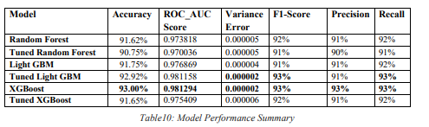
Performance Metrics
a.) Based on the internal model comparison, one can notice that XGBoost performs the best on all metrics having high ROC_AUC score, Precision and Recall along with the lowest bias and variance error.
b.) Second was the Tuned Light GBM model, which almost matched XGBoost in all the metrics.
c.) The two Random Forest models (hyper-parameter tuned and base model) and the Tuned XGBoost performed neck to neck.

Slide 71
Overfitting Test
1.However, accuracy is not the only metric to measure a model’s performance.
2.Since we had multiple models with high accuracy, we examined the differences between their respective training and testing accuracies.
3.The greater the difference, the greater the susceptibility of the model to being overfit.

Slide 72
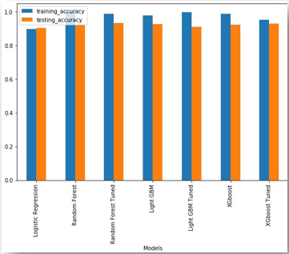
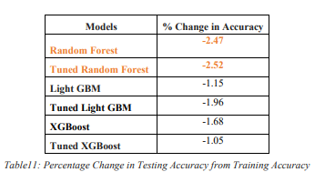

Slide 73
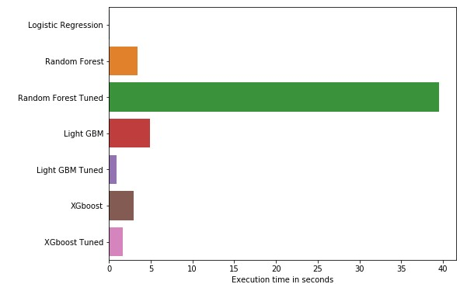
Execution Time
The below figure provides the final piece in the puzzle in helping determine the overall best model for this study.

Slide 74
FINAL SELECTION
After comparing the models on three different metrics, it was determined that the XGBoost model (Without tuning) was the best model out of the ones built for this study.
After seeing the initial results, there were concerns of overfitting due to its high accuracy and precision.
Upon cross validating AUC_ROC score, we found that the Tuned LightGBM model also had the lowest variance, suggesting that it also had the ability to adapt to changes in the data.
The Tuned Random Forest model performed well in most metrics, but its high execution time (39.55 s) resulted it in not being a viable option.
The Tuned LightGBM was the second-best model overall, due it clocking a 0.928 s execution time and bias and variance errors very similar to the XGBoost model.

Slide 75
FEATURE IMPORTANCE
Feature importance is one of the techniques to analyze the importance of each independent variable on the target variable.
We have used Random Forest Classifier as our model, and it has functions to calculate feature importance under the sk-learn library.
Therefore, a more robust technique Permutation Feature Importance is implemented in our project using scikit-learn library. Which assign a score to each feature and depicts how much overall accuracy of the model is affected due to each feature.

Slide 76
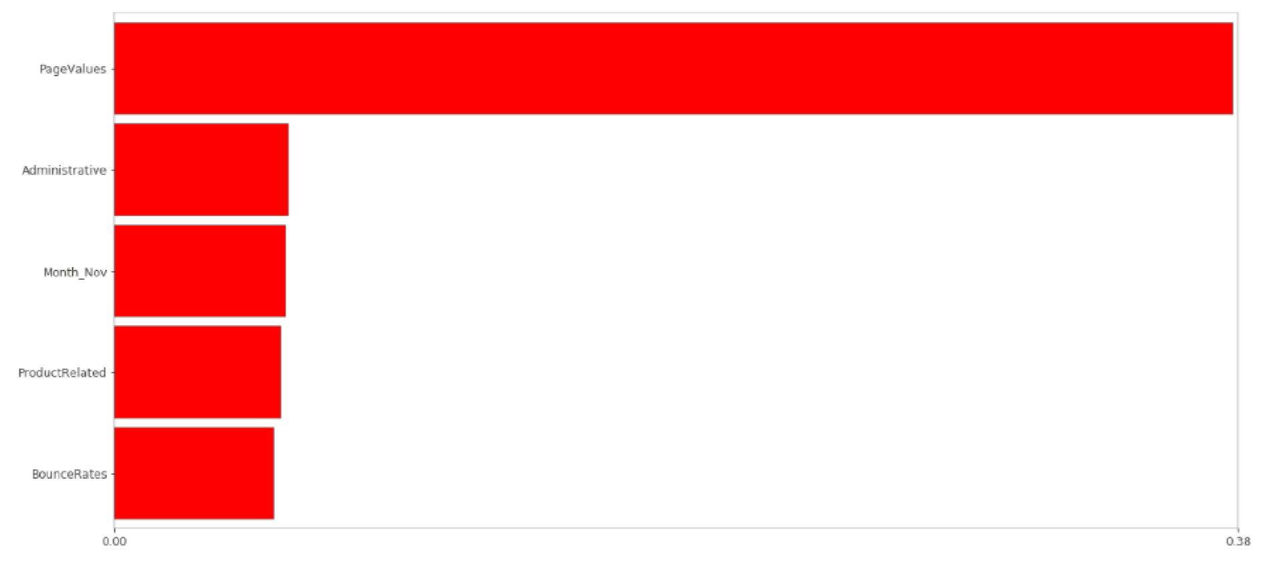
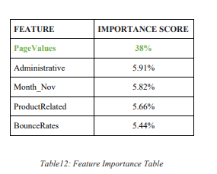
The following bar graph depicts the top features having more than 5% importance.

Slide 77
9. BUSINESS INSIGHTS 9.1 Methodological improvements:
Data Collection:
1.It had too many categorical features.
2.Addition of a few more numerical variables would be helpful in providing better inferences.
3.Certain features were found out to be insignificant during the statistical significance tests and could be dropped during the upcoming data collection process.
4.ExitRates proved to have been redundant because of the presence of BounceRates. Dropping them out would be wise from an economical perspective.

Slide 78
Preprocessing:
1.One hot encoding for the categorical features proved to be very exhaustive as the features themselves had too many numbers of sub-categories. This resulted in the increase of dimensionality.
2.Other encoding methods can be tried out if there is a time availability constraint.
3.The numerical features were found out to have a skewed distribution and primary transformations were applied to bring it into Gaussian distribution.
4.Advanced transformation techniques can be experimented to treat the extreme values.

Slide 79
Modeling:
1.Most of the classification algorithms resulted in models with a commendable ROC_AUC score.
2.Hyper-parameters can be tuned if the improvement of f1-score is the intention.
3.Neural Networks and other deep learning techniques can be used to build models which offer better generalization even though our models had a very considerate variance error.

Slide 80
9.2 Commercial /Research Value:
Commercial:
1.This study can be used to predict the intention of the online shopper. Our best models can be used for the same.
2.PageValues have proved to be the most crucial feature for predicting the intention.
3.BounceRates have been proved to be inversely proportional to the revenue generation. As a result, pages with high Bounce Rates could be managed better for better revenues.
4.Month of November was found to have the highest revenue generation, which in turn would indicate the surge of customers. Attractive offers can be put up to attract more customers.

Slide 81
Research Value:
1.There is further cope for research with respect to the clustering techniques. As this dataset contained high number of categorical features, k-modes was applied.
2. Other clustering techniques can be applied to finding out hidden patterns. This way, it could help in clusters with better similarity and certain products can be advertised to a specific cluster of shoppers.

Slide 82
9.3 RECOMMENDATIONS BASED ON INSIGHTS
XGBoost model without hyper-parameter tuning with a dataset balanced using SMOTE is the best method to predict the online shopper’s intention.
This conclusion was reached after comparing six different machine learning models on a dataset of standardized, one-hot and label encoded variables.
The XGBoost classifier not only performed well in accuracy wise, with an accuracy of 93%, precision of 93% and recall of 93% and AUC Score of 98%, but also adjusted well to changes in dataset (low variance error) and took a far lower time to execute compared to more complex algorithms that performed the same.

Slide 83
Regarding the studies related to Data Science studies, it is to be made clear that this study can be used only for prediction purposes and decision making despite good mathematical results.
Despite the impressive results, shopper’s behaviors and also the trend of the market may be subjected to changes in the upcoming days.
The important features can be used as a preliminary indicator of the intention of the shopper. The least important factors can be neglected during this process.
Coming to the second objective, XGBoost model without tuning can be used for the same. Other five models have also proved to be a challenger but can be used for experimentation

Slide 84

10. SUMMARY TABLE

Slide 85
Thank You

